Slide 1

BSC COMPANY
Revenue Analysis
GROUP4

Slide 2
Overview
Introduction : Megan Garcia
Variance Analysis : Shobhit Gahlot
Baseline Budgeting : Jayapratha Ganesan
Growth Scenarios: Sriram Ganne
New Products : Emily Garnier

Slide 3
PRODUCT CATEGORIES
Books
Electronics
Music
Movies

Slide 4
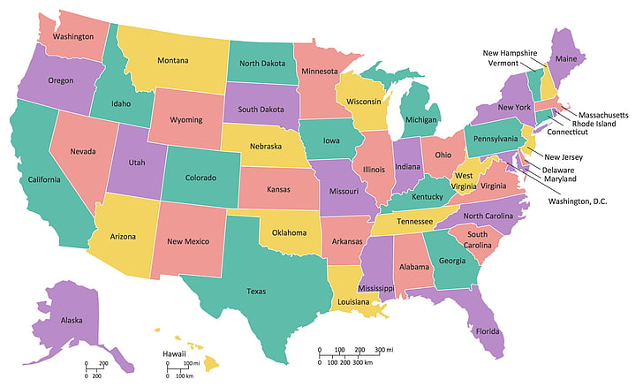
Seven Regions in the US Covering all 50 states
Online Store Covering The Nation

Slide 5
Variance Analysis
We can observe from the revenue analysis of the categories that Electronics revenue is the highest in each year.
We have found that the highest revenue variance percent is highest in the Northwest and the south region.
On comparing the variance in each year, we observe that for each category of the product the revenue has increased in each year.
To sum up the reasons of these observations we have found that in each year we have updated our product catalogue with the latest popular company products which has attracted more customers.
In the initial years of 2017, 2018 our product catalogue was limited and with each year we have created more partnerships with other companies which has improved our product catalogue.
Lastly some of these partnerships with other companies have allowed us to sell products at a discounted price which has attracted more customers.

Slide 6
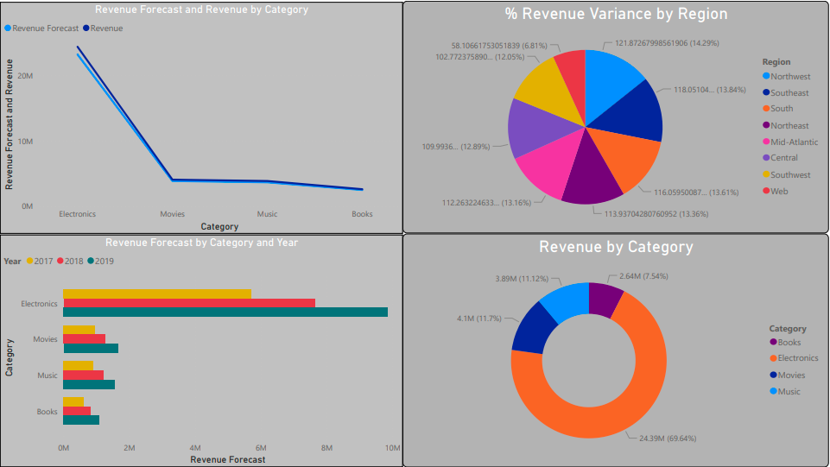
Analysis Visuals

Slide 7
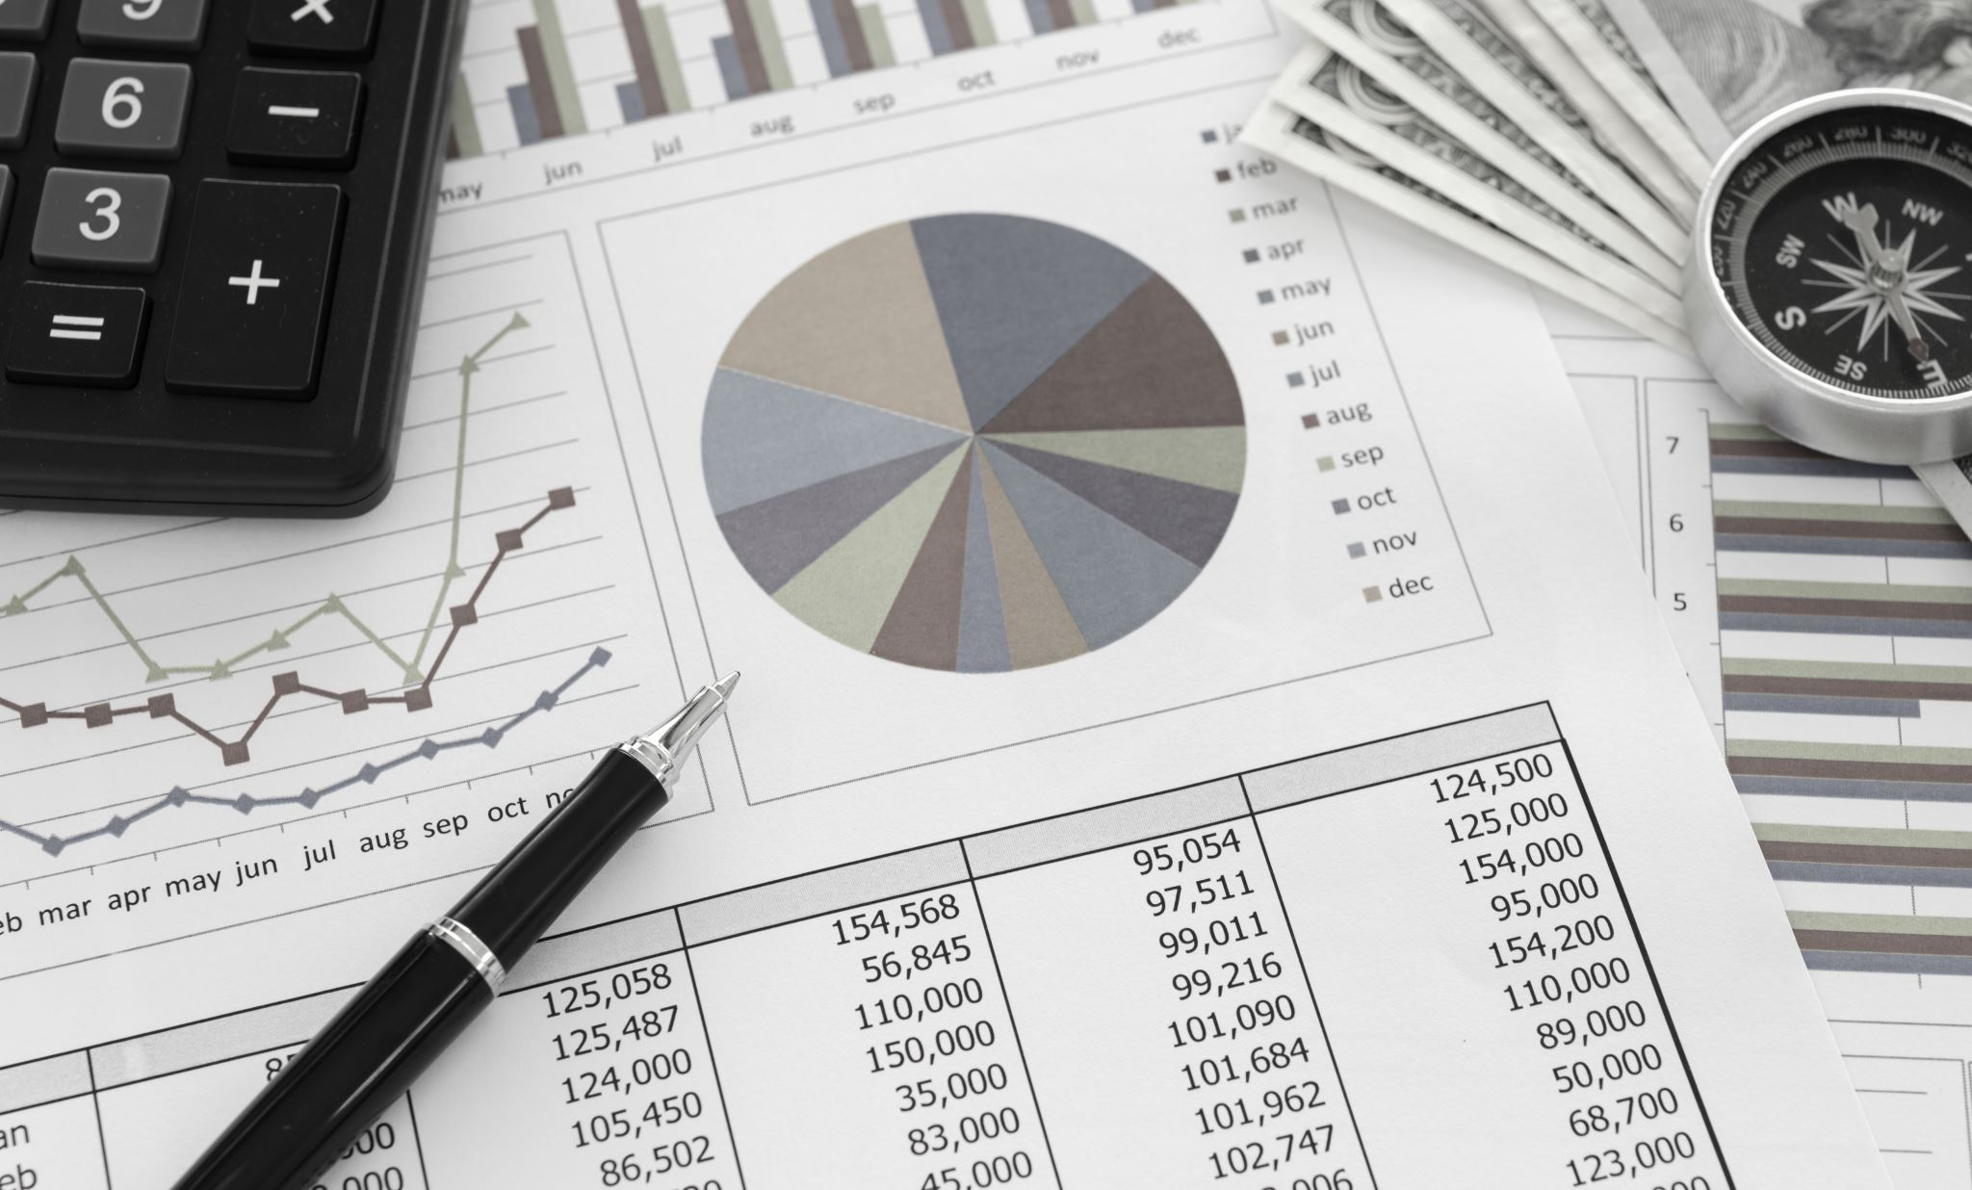
Baseline Budgeting

Slide 8
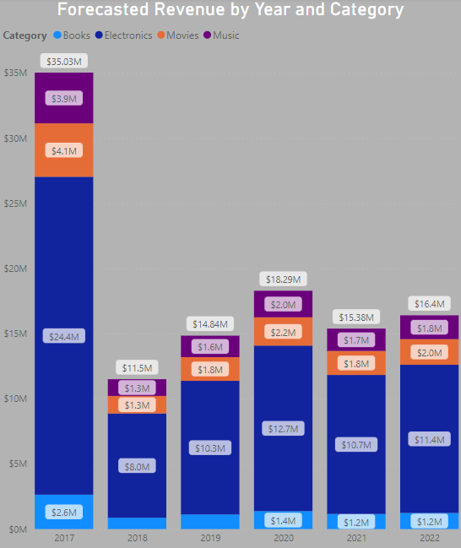
REVENUE TRENDS
Method used: Linear regression
Year 2020: High revenue figures in months of August, September and December
Year 2021: Drop in revenue trend
Year 2022: Increase in revenue trend

Slide 9
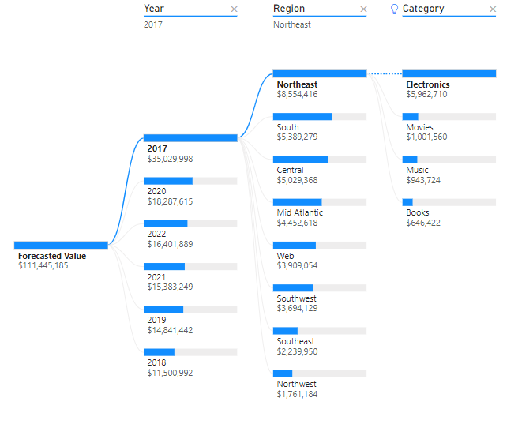
Analysis by region & product
Critical Categories
Region
Contribution
Subcategory
Reason

Slide 10
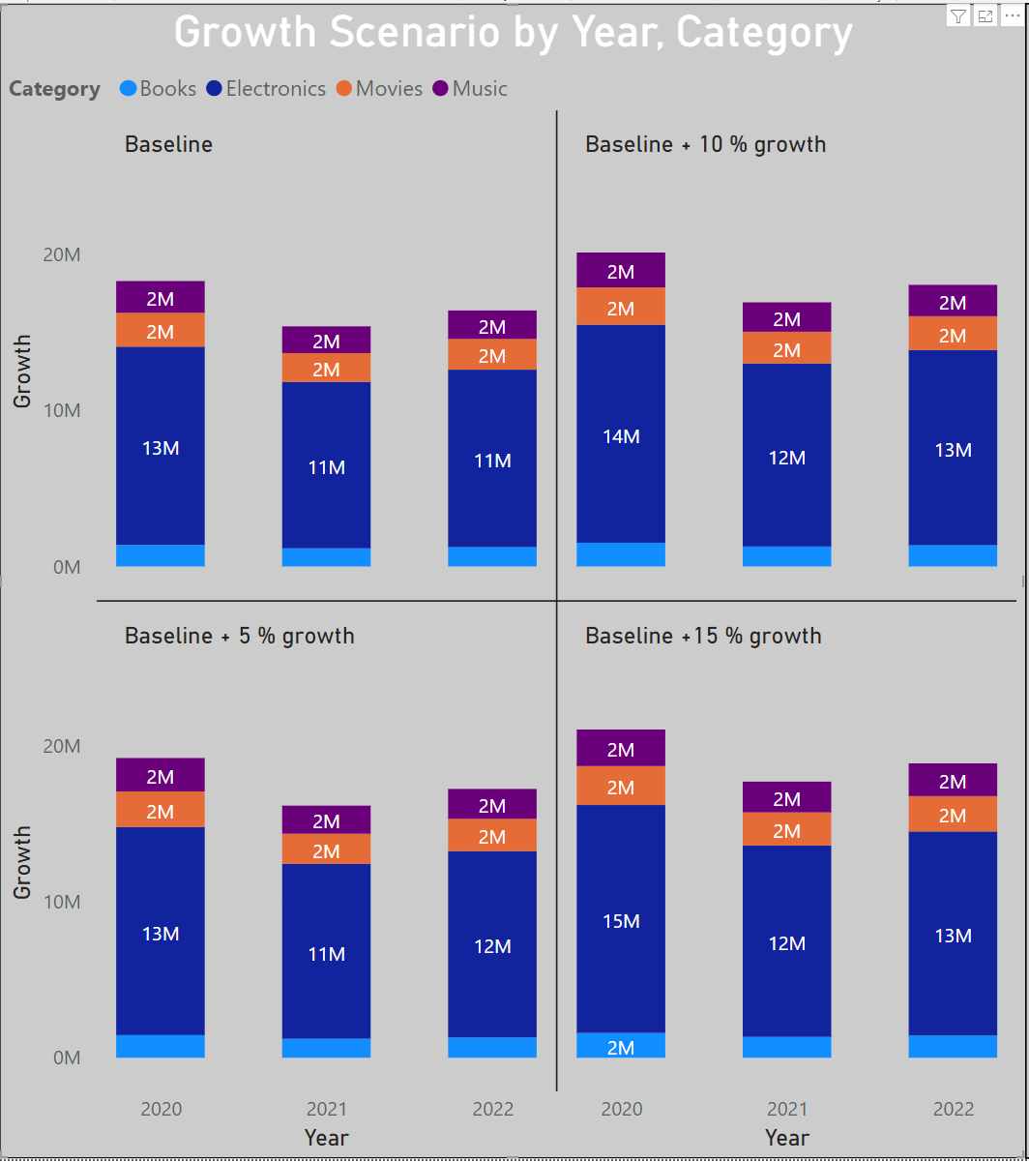
Baseline growth scenarios

Slide 11
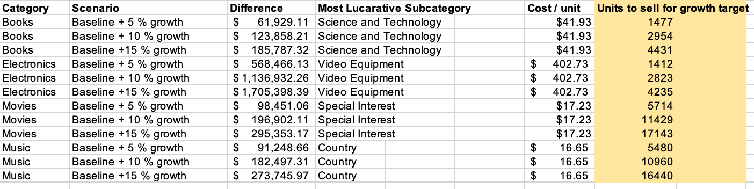
how scenarios can be Attained?
Goal – To attain the Baseline 5%, 10%, 15 % growth rate per year
Approach – Investing in a subcategory for each product to deliver expected results
Selected subcategories based on the analysis
Books – Science and technology
Electronics – Video equipment
Movies – Special Interest
Music – Country

Slide 12
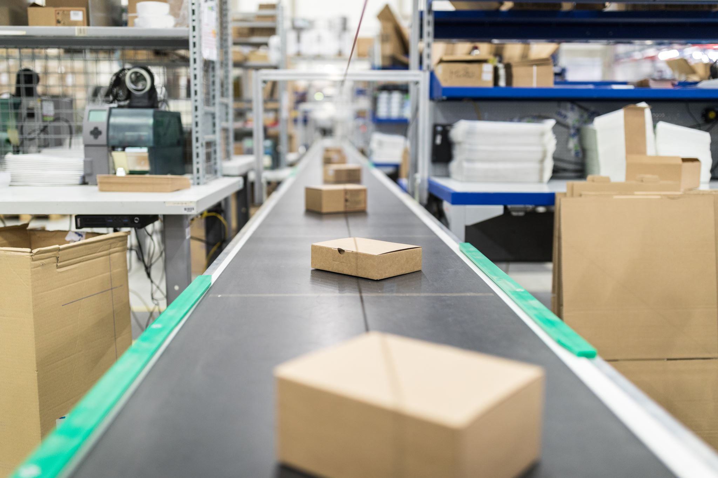
New Products
Introduce two new products to achieve growth goals
New products can strategically stimulate the consumer market to buying more of BSC products

Slide 13
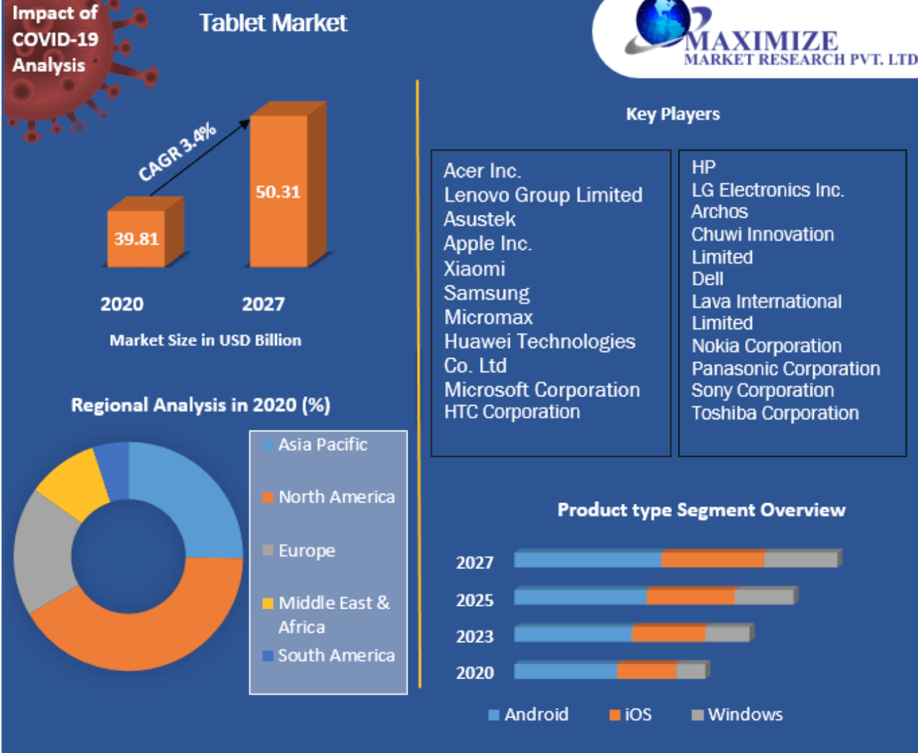
Tablets
Why Electronics category?
Could lead to higher sales in movies, books, and music
Market size in the US is predicted to increase greatly in the coming years

Slide 14

Loud speakers
Why speakers?
Speakers can be used to play music, read audio books, and play sound for movies.
Speakers are also seeing a great increase in sales across the US

Slide 15

Potential risk
High brand recognition of competitors
Overcome risks with proper marketing and packaged deals for discounts on other BSC products such as movies, books, and music

Slide 16
Thank you !

